Slide 1


Stat 4600 INTERMEDIARY STATISTICAL MODELLING & ANALYTICS
6th November, 2021

Slide 2
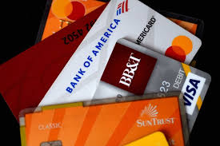
Analysis of delinquency trend for credit card repayments
Group 4
Group members:
Chandrika Rai
Charesh Battepati
Gia Phu Pham
Tejas Mirashi

Slide 3
The Business Analytics Problem
The credit card business has been one of the major revenue sources for banks and financial institutions.
With the advent of digitization and fierce competition among banks and finance companies to bag the largest market share, the credit risk analysis has also undergone a change.
Resultantly, there is always a hanging sword on the credit and risk department of these institutions that a sudden spike in the delinquency levels might hit the portfolio health.
So, how do we deal with this problem? The sheer size of transactions is quite intriguing to the naked eye.

Slide 4
Study Design: Analysis
Delinquency analysis using the data points of the already delinquent customers. This technique in the finance industry is known as ‘analysis of portfolio cuts’
An ‘Early Warning Signal’ (EWS) system using the analysis in the earlier point is developed which can be used by the credit and risk department to flag off the potential defaulters before hand.
Out the total around 550,000 customers in the dataset, about 2,000 customers have currently defaulted on credit card payments for 1 day or more, up to 150 days, above which the account is written-off as bad debts.

Slide 5
Study design: Modeling techniques
The following modeling techniques are used for analysis:
Simple linear regression
Multivariable regression
Logistic regression
Exploratory data analysis
Further, the techniques prescribed can be used as score-card by the credit and risk department for analysis to decide for extending a credit line to a customer which can drastically reduce the turnaround time for a decision.

Slide 6
Description of dataset

Slide 7
Type:
Type of dataset
Nominal
Ordinal
Discrete
Continuous
Source:
The data is taken from Kaggle datasets which is a web service platform for data. https://www.kaggle.com/laotse/credit-card-approval

Slide 8
Content:
The dataset is about credit card risk analysis. The dataset has 19 columns, 537667 Rows with the following variables and description.
Feature Name | Description
ID | Client Number
CODE_GENDER | Gender
FLAG_OWN_CAR | Is there a car
FLAG_OWN_REALTY | Is there a property
CNT_CHILDREN | Number of Children
AMT_INCOME_TOTAL | Annual Income
NAME_EDUCATION_TYPE | Education Level
NAME_FAMILY_STATUS | Marital Status
NAME_HOUSING_TYPE | Way of Living
DAYS_BIRTH | Age in years
DAYS_EMPLOYED | Duration of work in years
FLAG_MOBIL | Duration of work in years

Slide 9
Content:
Feature Name | Description
FLAG_WORK_PHONE | Is there a mobile phone
FLAG_PHONE | Is there a work phone
FLAG_EMAIL | Is there a phone
JOB | Is there an email
BEGIN_MONTHS | Job
STATUS | 0: 1-29 days past due 1: 30-59 days past due 2: 60-89 days overdue 3: 90-119 days overdue 4: 120-149 days overdue 5: Overdue or bad debts, write-offs for more than 150 days C: paid off that month X: No loan for the month
TARGET | Risk users are marked as '1', else are '0'

Slide 10
Analysis:

Slide 11
Analysis and Modelling methods:
Descriptive analysis
Diagnostic Analysis
Predictive Analysis
Prescriptive analysis
Charts, graphs, and tables will be created to visualize data on the dependent variables and independent variables by grouping the data into classes.
Next, using data visualization, we provide analysis for the risk department.
For analysis Python programing language will be used for this project.

Slide 12
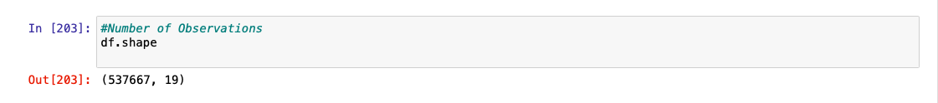
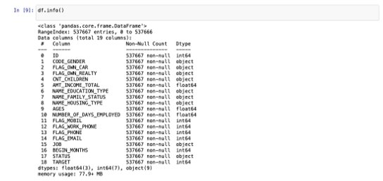
Exploratory Data Analysis
The dataset comprises of 537667 observations and 19 characteristics
Out of which Target is the dependent variable and the rest 18 are independent variables
The data has float, integer values and objects
No variable-column has null/missing values

Slide 13
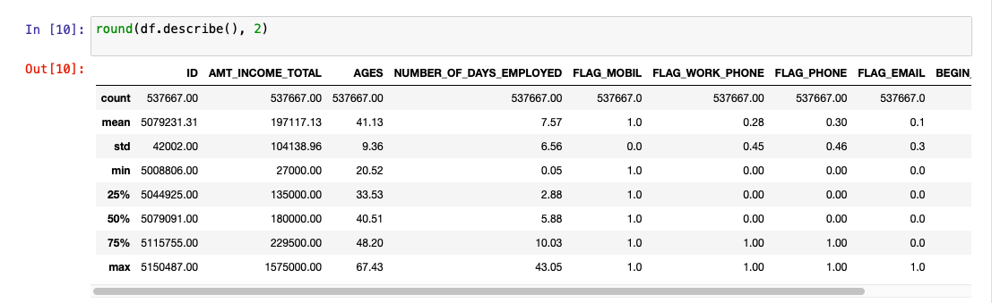
Exploratory Data Analysis Cont.
The mean is larger than the median, the histogram is right-skewed distribution and vice-versa
There is notably a large difference between the 75th %tile and max values of the variable Annual Income, which means that in this variable, we have a lot of outliers

Slide 14
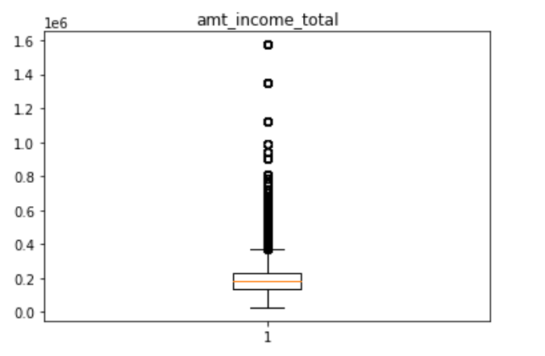
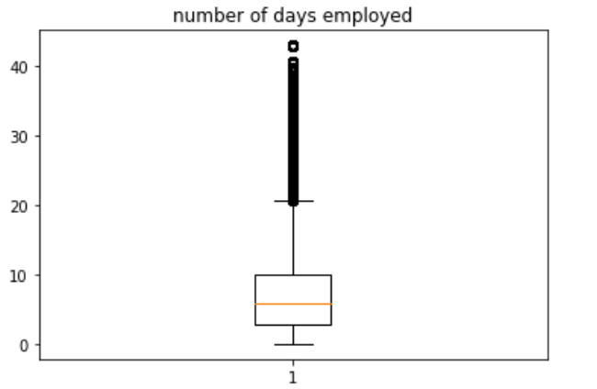
Exploratory Data Analysis Cont.

Slide 15
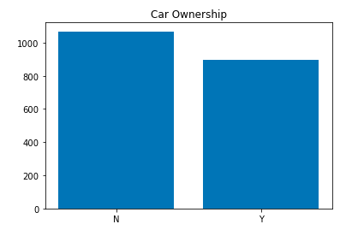
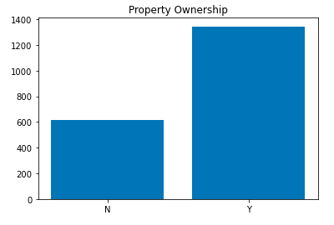
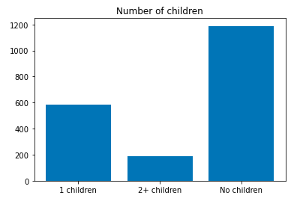
Simple Linear Regression Analysis:

Slide 16
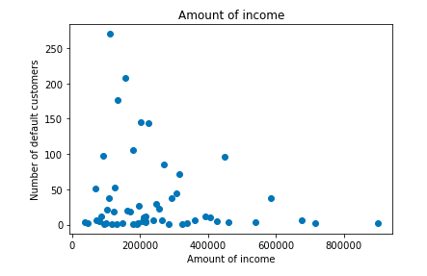
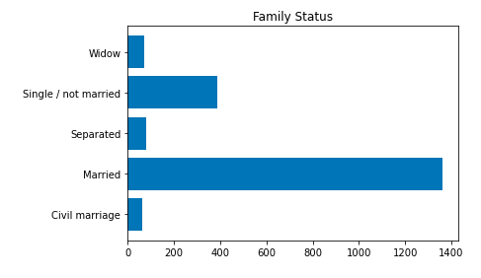
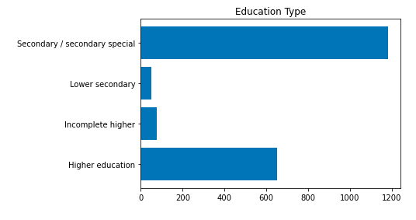

Slide 17
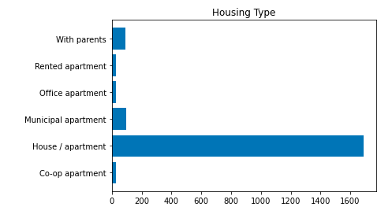
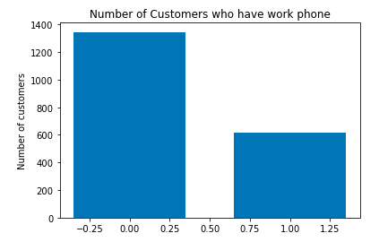
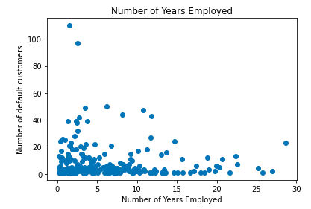

Slide 18
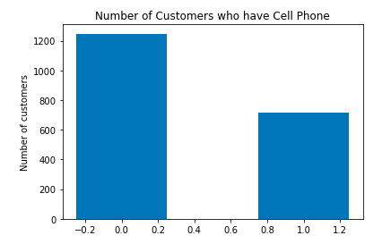
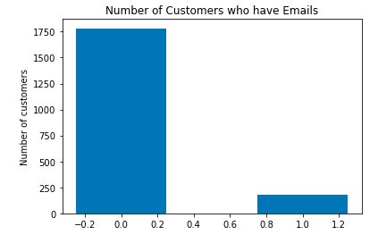

Slide 19
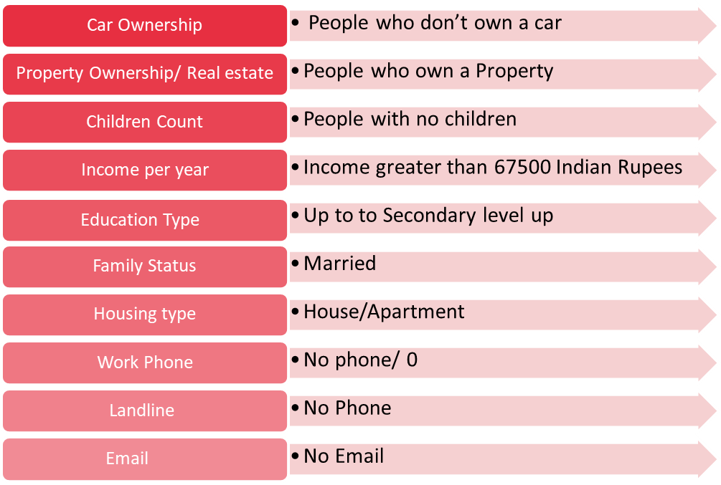
Important Factors:
These factors play an important role in making decisions to analyze if the good customers would be potential defaulters

Slide 20
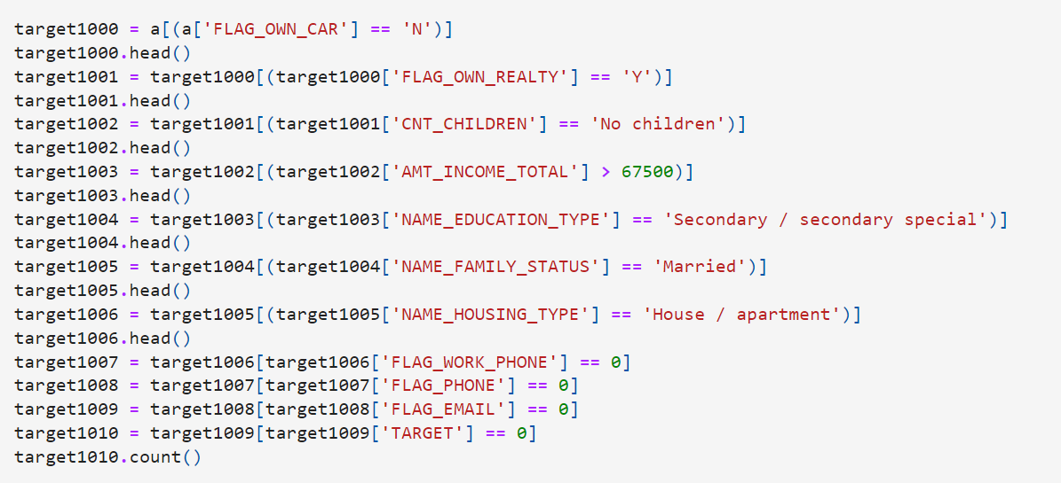
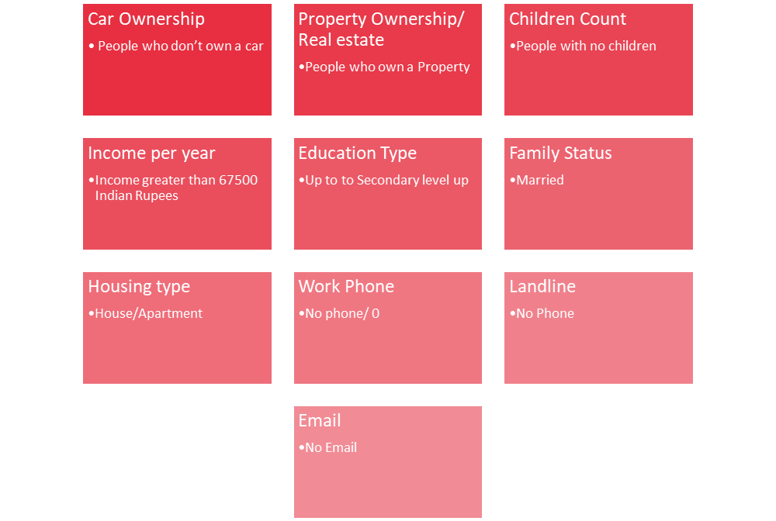
Future Predictions:
Variables to identify default people in future.
10 crucial variables for credit risk analysis out of 19 variables
Based on these factors/variables; out of 537667 people 32626 people are more prone to default or riskier in future.
So, the probability of default people in future is 0.06 which is equal to 6.09% of overall population.

Slide 21
Prescriptive Analysis:
Using this analysis, we can develop a scorecard for risk analysis.
The banks or financial institutions may use the scorecard to develop a detailed ranking system for filtering of credit card applications.
Some additional parameters such as tightening of FICO score, restricting the line of credit for flagged off customers etc. can be implemented.
The predicted delinquency is already at 6.09%. The organization can reconsider at the criteria for writing off bad debts keeping the regulatory guidelines and compliance in mind.

Slide 22
Limitations
The dataset only includes 537667 records of Indian consumers, there might be differences between recorded consumers and non- recorded consumers.
Demographic data is missing in the dataset which could have enhanced the analysis.
Time constraint
Model can be improved with more data and computational resources.

Slide 23
Conclusion and findings:
Learnt about the customer behavior and characteristics.
Found 10 crucial factors to detect potential dafaulters.
32.6k customers are at future risk.
Customers with property can also have default risk.
Model can be served as an aid to human decision.

Slide 24
References:
The data is taken from Kaggle datasets which is a web service platform for data. https://www.kaggle.com/laotse/credit-card-approval
https://core.ac.uk/download/pdf/77009321.pdf
https://citeseerx.ist.psu.edu/viewdoc/download?doi=10.1.1.1024.2660&rep=rep1&type=pdf

